Slide 1
Control Structures: Iterative Control
Bordoloi and Bock

Slide 2
SIMPLE LOOPS
A simple loop, as you can see from its name, is the most basic kind of loop and has the following structure:
      LOOP
      STATEMENT 1;
      STATEMENT 2;
      ….
      STATEMENT N;
      END LOOP;
The reserved word LOOP marks the beginning of the simple loop.
Statements 1 through N are a sequence of statements that is executed repeatedly.
These statements consist of one or more of the standard programming structures.
END LOOP is a reserved phrase that indicates the end of the loop construct.
Bordoloi and Bock

Slide 3
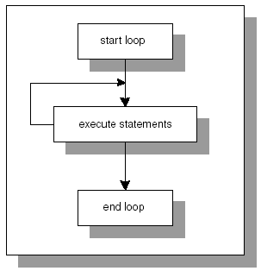
SIMPLE LOOPS
Every time the loop is iterated, a sequence of statements is executed, then control is passed back to the top of the loop.
The sequence of statements will be executed an infinite number of times because there is no statement specifying when the loop must terminate.
Hence, a simple loop is called an infinite loop because there is no means to exit the loop.
Bordoloi and Bock

Slide 4
Exit
The EXIT statement causes a loop to terminate when the EXIT condition evaluates to TRUE.
The EXIT condition is evaluated with the help of an IF statement.
When the EXIT condition is evaluated to TRUE, control is passed to the first executable statement after the END LOOP statement.
Bordoloi and Bock

Slide 5
Exit
      LOOP
      STATEMENT 1;
      STATEMENT 2;
      IF CONDITION
      THEN
      EXIT;
      END IF;
      END LOOP;
      STATEMENT 3;
In this example, you can see that after the EXIT condition evaluates to TRUE, control is passed to STATEMENT 3, which is the first executable statement after the END LOOP statement.
Bordoloi and Bock

Slide 6
EXIT WHEN
The EXIT WHEN statement causes a loop to terminate only if the EXIT WHEN condition evaluates to TRUE.
Control is then passed to the first executable statement after the END LOOP statement.
The structure of a loop using an EXIT WHEN clause is as follows:
        LOOP
        STATEMENT 1;
        STATEMENT 2;
        EXIT WHEN CONDITION;
        END LOOP;
        STATEMENT 3;
Bordoloi and Bock

Slide 7
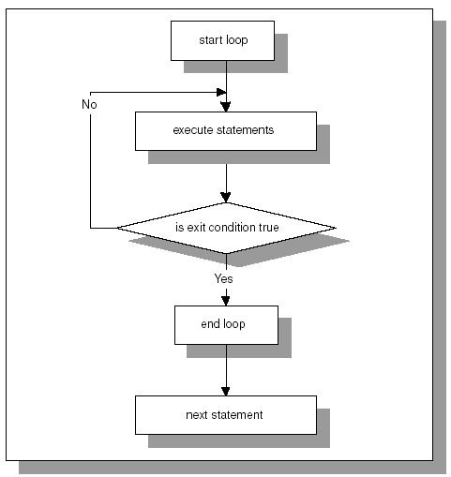
EXIT WHEN
Bordoloi and Bock

Slide 8
EXIT
When the EXIT statement is used without an EXIT condition, the simple loop will execute only once.
Example.
      DECLARE
      v_counter NUMBER := 0;
      BEGIN
      LOOP
      DBMS_OUTPUT.PUT_LINE('v_counter ' = ||v_counter);
      EXIT;
      END LOOP;
      END;
Bordoloi and Bock

Slide 9
EXIT
This example produces the output:
    v_counter = 0
    PL/SQL procedure successfully completed.
Because the EXIT statement is used without an EXIT CONDITION, the loop is terminated as soon as the EXIT statement is executed.
Bordoloi and Bock

Slide 10
WHILE LOOPS
A WHILE loop has the following structure:
      WHILE CONDITION
      LOOP
      STATEMENT 1;
      STATEMENT 2;
      …
      STATEMENT N;
      END LOOP;
Bordoloi and Bock

Slide 11
WHILE LOOPS
The reserved word WHILE marks the beginning of a loop construct.
The word CONDITION is the test condition of the loop that evaluates to TRUE or FALSE.
The result of this evaluation determines whether the loop is executed.
Statements 1 through N are a sequence of statements that is executed repeatedly.
The END LOOP is a reserved phrase that indicates the end of the loop construct.
Bordoloi and Bock

Slide 12
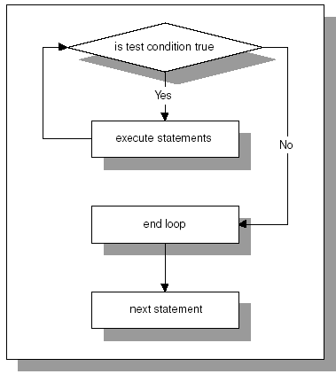
WHILE LOOP
The test condition is evaluated prior to each iteration of the loop.
If the test condition evaluates to TRUE, the sequence of statements is executed, and the control is passed to the top of the loop for the next evaluation of the test condition.
If the test condition evaluates to FALSE, the loop is terminated, and the control is passed to the next executable statement following the loop.
Bordoloi and Bock

Slide 13
Example
In this example the body of the loop is not executed at all because the test condition of the loop evaluates to FALSE.
While the test condition of the loop must evaluate to TRUE at least once for the statements in the loop to execute, it is important to insure that the test condition will eventually evaluate to FALSE as well.
Otherwise, the WHILE loop will execute continually.
DECLARE
v_counter NUMBER := 5;
BEGIN
WHILE v_counter < 5
LOOP
DBMS_OUTPUT.PUT_LINE ('v_counter = '||v_counter);
-- decrement the value of
-- v_counter by one
v_counter := v_counter - 1;
END LOOP;
END;
Bordoloi and Bock

Slide 14
Example
This is an example of the infinite WHILE loop.
The test condition always evaluates to TRUE because the value of v_counter is decremented by 1 and is always less than 5.
DECLARE
v_counter NUMBER := 1;
BEGIN
WHILE v_counter < 5
LOOP
DBMS_OUTPUT.PUT_LINE ('v_counter = '||v_counter);
-- decrement the value of v_counter by one
v_counter := v_counter - 1;
END LOOP;
END;
Bordoloi and Bock

Slide 15
Use of Boolean Values to exit Loop
Boolean expressions can be used to determine when the loop should terminate.
    DECLARE
    v_test BOOLEAN := TRUE;
    BEGIN
    WHILE v_test
    LOOP
    STATEMENTS;
    IF TEST_CONDITION
    THEN
    v_test := FALSE;
    END IF;
    END LOOP;
    END;
Bordoloi and Bock

Slide 16
Premature Termination of Loop
The EXIT and EXIT WHEN statements can be used inside the body of a WHILE loop.
If the EXIT condition evaluates to TRUE before the test condition evaluates to FALSE, the loop is terminated prematurely.
If the test condition yields FALSE before the EXIT condition yields TRUE, there is no premature termination of the loop.
Bordoloi and Bock

Slide 17
Example
DECLARE
v_counter NUMBER := 1;
BEGIN
WHILE v_counter <= 2
LOOP
DBMS_OUTPUT.PUT_LINE
('v_counter = '||v_counter);
v_counter := v_counter + 1;
IF v_counter = 5
THEN
EXIT;
END IF;
END LOOP;
END;
In this example, the test condition is
v_counter <= 2 and the EXIT condition is v_counter = 5
So, in this case, the loop is executed twice as well.
However, it does not terminate prematurely because the EXIT condition never evaluates to TRUE.
As soon as the value of v_counter reaches 3, the test condition evaluates to FALSE, and the loop is terminated.
Bordoloi and Bock

Slide 18
NUMERIC FOR LOOPS
A numeric FOR loop is called numeric because it requires an integer as its terminating value.
Its structure is as follows:
  FOR loop_counter IN[REVERSE] lower_limit..upper_limit
  LOOP
  STATEMENT 1;
  STATEMENT 2;
  …
  STATEMENT N;
  END LOOP;
Bordoloi and Bock

Slide 19
FOR LOOP
The reserved word FOR marks the beginning of a loop construct.
The variable, loop_counter, is an implicitly defined index variable. So, there is no need to define loop counter in the declaration section of the PL/SQL block.
This variable is defined by the loop construct.
Lower_limit and upper_limit are two integer numbers that define the number of iterations for the loop.
The values of the lower_limit and upper_limit are evaluated once, for the first iteration of the loop. At this point, it is determined how many times the loop will iterate.
Statements 1 through N are a sequence of statements that is executed repeatedly.
END LOOP is a reserved phrase that marks the end of the loop construct.
Bordoloi and Bock

Slide 20
FOR LOOP
The reserved word IN or IN REVERSE must be present when defining the loop. If the REVERSE keyword is used, the loop counter will iterate from upper limit to lower limit.
However, the syntax for the limit specification does not change.
The lower limit is always referenced first.
Bordoloi and Bock

Slide 21
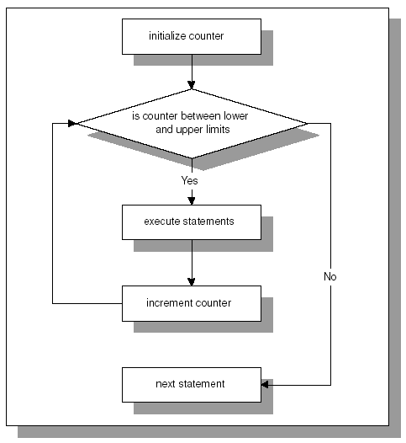
FOR LOOP
Bordoloi and Bock

Slide 22
Example
BEGIN
FOR v_counter IN 1..5
LOOP
DBMS_OUTPUT.PUT_LINE ('v_counter = '||v_counter);
END LOOP;
END;
OUTPUT
v_counter = 1
v_counter = 2
v_counter = 3
v_counter = 4
v_counter = 5
PL/SQL procedure successfully
completed.
In this example, there is no declaration section for this PL/SQL block because the only variable used, v_counter, is the loop counter.
Numbers 1..5 specify the range of the integer numbers for which this loop is executed.
Notice that there is no statement v_counter := v_counter + 1 anywhere, inside or outside the body of the loop.
The value of v_counter is incremented implicitly by the FOR loop itself.
Bordoloi and Bock

Slide 23
EXAMPLE
As a matter of fact, if you include the statement
v_counter := v_counter + 1 in the body of the loop, PL/SQL script will compile with errors.
      BEGIN
      FOR v_counter IN 1..5
      LOOP
      v_counter := v_counter + 1;
      DBMS_OUTPUT.PUT_LINE('v_counter = '|| v_counter);
      END LOOP;
      END;
Output
      BEGIN
      *
      ERROR at line 1:
      ORA-06550: line 3, column 7:
      PLS-00363: expression 'V_COUNTER' cannot be used as
      an assignment target
      ORA-06550: line 3, column 7:
      PL/SQL: Statement ignored
Bordoloi and Bock

Slide 24
Using the REVERSE option in the loop
Output
v_counter = 5
v_counter = 4
v_counter = 3
v_counter = 2
v_counter = 1
PL/SQL procedure
successfully completed.
BEGIN
FOR v_counter IN REVERSE 1..5
LOOP
DBMS_OUTPUT.PUT_LINE ('v_counter = '||v_counter);
END LOOP;
END;
Bordoloi and Bock

Slide 25
Premature Termination Of The Loop
The EXIT and EXIT WHEN statements can be used inside the body of a numeric FOR loop.
If the EXIT condition evaluates to TRUE before the loop counter reaches its terminal value, the FOR loop is terminated prematurely.
If the loop counter reaches its terminal value before the EXIT condition yields TRUE, there is no premature termination of the FOR loop.
Bordoloi and Bock

Slide 26
Example
  BEGIN
  FOR v_counter IN 1..5
  LOOP
  DBMS_OUTPUT.PUT_LINE(‘v_counter = ’||v_counter);
  EXIT WHEN v_counter = 3;
  END LOOP;
  END;
Bordoloi and Bock

Slide 27
NESTED LOOPS
Simple loops, WHILE loops, and numeric FOR loop can be nested inside one another.
For example, a simple loop can be nested inside a WHILE loop and vice versa.
Bordoloi and Bock

Slide 28
Example
    DECLARE
    v_counter1 INTEGER := 0;
    v_counter2 INTEGER;
    BEGIN
    WHILE v_counter1 < 3
    LOOP
    DBMS_OUTPUT.PUT_LINE('v_counter1: '||v_counter1);
    v_counter2 := 0;
    LOOP
    DBMS_OUTPUT.PUT_LINE('v_counter2: '||v_counter2);
    v_counter2 := v_counter2 + 1;
    EXIT WHEN v_counter2 >= 2;
    END LOOP;
    v_counter1 := v_counter1 + 1;
    END LOOP;
    END;
Bordoloi and Bock

Slide 29
Example explained
In this example, the WHILE loop is called an outer loop because it encompasses the simple loop.
The simple loop is called an inner loop because it is enclosed by the body of the WHILE loop.
The outer loop is controlled by the loop counter, v_counter1, and it will execute providing the value of v_counter1 is less than 3.
With each iteration of the loop, the value of v_counter1 is displayed on the screen.
Next, the value of v_counter2 is initialized to 0. It is important to note that v_counter2 is not initialized at the time of the declaration.
The simple loop is placed inside the body of the WHILE loop, and the value of v_counter2 must be initialized every time before control is passed to the simple loop.
Bordoloi and Bock

Slide 30
Example explained
Once control is passed to the inner loop, the value of v_counter2 is displayed on the screen, and incremented by 1.
Next, the EXIT WHEN condition is evaluated. If the EXIT WHEN condition evaluates to FALSE, control is passed back to the top of the simple loop.
If the EXIT WHEN condition evaluates to TRUE, the control is passed to the first executable statement outside the loop.
In our case, control is passed back to the outer loop, and the value of v_counter1 is incremented by 1, and the TEST condition of the WHILE loop is evaluated again.
Bordoloi and Bock

Slide 31
Output
  v_counter1: 0
  v_counter2: 0
  v_counter2: 1
  v_counter1: 1
  v_counter2: 0
  v_counter2: 1
  v_counter1: 2
  v_counter2: 0
  v_counter2: 1
  PL/SQL procedure successfully completed.
Bordoloi and Bock

Slide 32
LOOP LABELS
Loops can be labeled in the similar manner as PL/SQL blocks.
    <<label_name>>
    FOR LOOP_COUNTER IN LOWER_LIMIT..UPPER_LIMIT
    LOOP
    STATEMENT 1;
    …
    STATEMENT N;
    END LOOP label_name;
Bordoloi and Bock

Slide 33
LOOP LABELS
The label must appear right before the beginning of the loop.
This syntax example shows that the label can be optionally used at the end of the loop statement.
It is very helpful to label nested loops because labels improve readability.
        BEGIN
        <<outer_loop>>
        FOR i IN 1..3
        LOOP
        DBMS_OUTPUT.PUT_LINE('i = '||i);
        <<inner_loop>>
        FOR j IN 1..2
        LOOP
        DBMS_OUTPUT.PUT_LINE('j = '||j);
        END LOOP inner_loop;
        END LOOP outer_loop;
        END;
Bordoloi and Bock

Slide 34

END
Bordoloi and Bock

